Slide 1

EXXONMOBIL DATAWORKS CHALLENGE 2026
A Machine-Learning Proxy for Reservoir Simulation
Team: Intern’s Level
University: University Malaya
Team member:
  Choong Ming Hang
  Koay Khoon Lyn
  Tan Pei Ying
  Lam Zhuo Yi

Slide 2
THE BUSINESS QUESTION
Will this field make money over the next 20 years?
1 · PAST
2 · MATCH
3 · FORECAST
4 · DECIDE
Real field history, 1998–2008
Find reservoir settings that reproduce it
Oil, gas and water, 2008–2028
Invest, plan facilities, manage water
The physics simulator is slow, so we build a fast ML copy (a proxy) to test many settings.
T1 · Business & data
1

Slide 3
From raw files to one clean table
1 · ALIGN
2 · FIX RATES
3 · SPLIT
Keep the 41 quarterly dates where the real field was measured: exact values, nothing estimated
Simulator and real rates were 3 months apart, so every rate is recomputed from the cumulative totals
Organisers’ split: train 1–70, validation 71–85, test 86–100
100 rows
One master table: each simulated case with its 4 parameters and 123 outputs (oil, gas, water × 41 dates)
Rules: real history is never a training target · test cases are used only once · the data stays confidential
T1 · Business & data
2

Slide 4
One shared score, and the baseline to beat
How the score works
BASELINE TO BEAT
  Gap between a curve and the real field, as a share of the field’s maximum
  Oil, gas and water count one third each
  0 = perfect; first 3 quarters skipped (no production yet)
0.0036
Case 6, best of the 100 existing cases: off by about 0.4% of the field maximum
Porosity ≈ 1.36 in all top cases: the history pins it down
The other 3 vary widely: different reservoirs fit equally well
All top cases miss 2007–08: too much oil and gas, too little water
T1 · Business & data
3

Slide 5
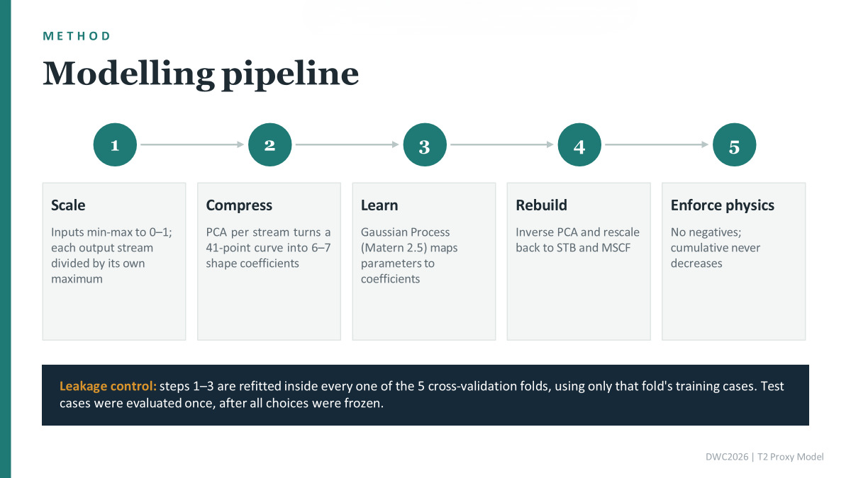

Slide 6
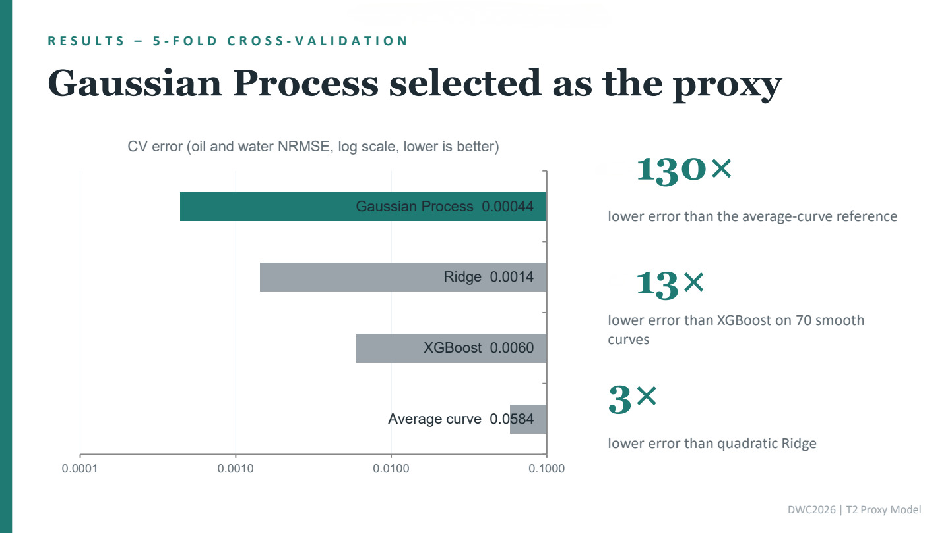

Slide 7
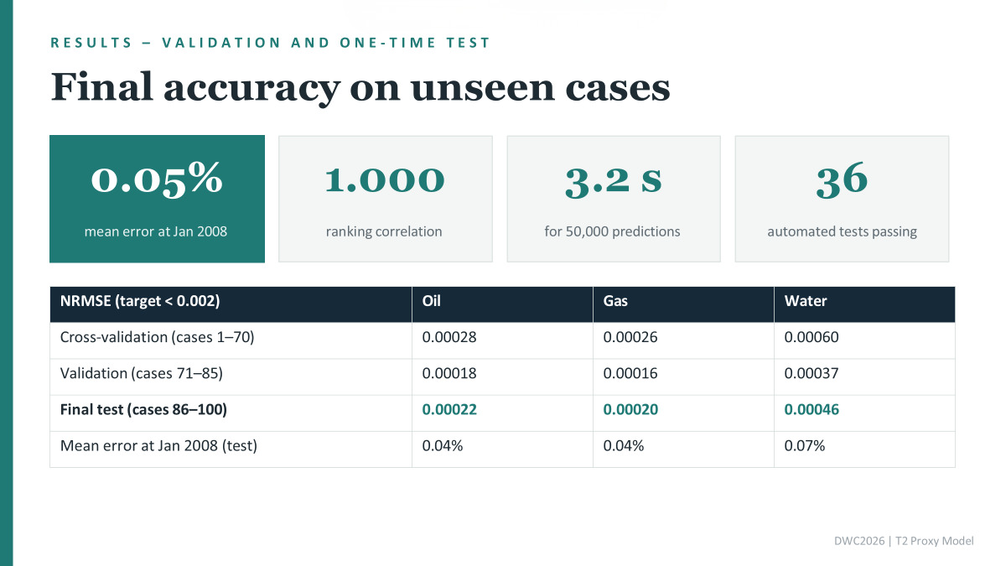

Slide 8
History match: a better group of 10
50,000
10
−19%
parameter sets tested with the proxy
kept: they fit history well and differ from each other
average score vs the organisers’ top 10 (0.003655 vs 0.004528; lower is better)
Best single set: 0.003454 vs Case 6’s 0.003559, a tie. Our scores are proxy-estimated; the organisers’ are simulator scores.
T3 · History match & forecast
1
Notes:
Using the proxy, we tested 50,000 parameter sets and kept ten that fit the history well and differ from each other. Our best set ties with the organisers’ best case. But as a group, our ten sets score about 19 percent lower, which means better, than the organisers’ top ten. (about 20 seconds)
1

Slide 9
Forecast methods, chosen by a cold test
1998–2003: start-up and plateau
2003–2005: fit
2005–2008: hidden, then checked
Oil and gas: decline curve shape
Water: water-oil ratio (WOR) trend
Method | Error | Result
Exponential (b = 0) | −11.9% | Too low, dropped
Hyperbolic (b free) | b hit 1 | Same as b = 1
Harmonic (b = 1) | −0.2% | Chosen
Method | Error | Result
WOR vs time | +51% | Dropped
Logistic water cut | +51% | Dropped
WOR vs cumulative oil | +15% | Chosen
Error = cumulative 2005–2008, forecast vs the hidden proxy curve (3-year cold test).
Water cap
Oil + water ≤ 13,248 bbl/day (highest of the last 8 history quarters); above it, water = cap − oil. Without the cap, total liquid keeps hitting new highs and 2028 water rises from 87.6M to 101.3M STB.
T3 · History match & forecast
2
Notes:
To choose our forecast methods, we ran a cold test: we hid the data from 2005 to 2008, forecast those years from the earlier data, and checked the error. Based on the results, we chose an Arps decline curve for oil and gas. For water, we chose the water-oil ratio against cumulative oil, because it had the lowest error, about 15 percent. On top of that, every forecast starts from the real 2008 production, and total liquid is capped at its recent level. (about 30 seconds)
2

Slide 10
The forecast to 2028
MOST LIKELY (P50), CUMULATIVE BY 2028
P10
high (optimistic)
59.7M STB
P90
low (conservative)
oil
Warning: the 10 cases differ by only ~0.6%. They fit the same history, so our method cannot see their differences.
21.7M MSCF
87.6M STB
gas
water
Main scenario, median of our 10 cases; all values proxy-estimated.
T3 · History match & forecast
3
Notes:
Our most likely forecast, P50, is about 59.7 million barrels of cumulative oil by 2028. It turns out that our ten cases differ by only 0.6 percent. That is not real certainty: since they all fit the same history, our method cannot see their differences. (about 20 seconds)
3

Slide 11

Main limitation: too much oil, too little water
Oil, end of history
Water, end of history
+12–15%
−10–11%
From the same 50,000 sets, the ones that fit 2005–2008 best matched the whole 1998–2008 history 7–10× worse. So we kept our 10.
The bias already exists in the simulated cases. Oil + water together is within 1.5% of the real field.
T3 · History match & forecast
4
Notes:
Our main limitation: at the end of the history, the model gives 12 to 15 percent too much oil and about 10 percent too little water. This bias comes from the simulated cases, and changing the parameters cannot fix it. We checked this: from the same 50,000 parameter sets, we picked the ones that fit only 2005 to 2008 best. They did fit those years better, but their match over the whole 1998 to 2008 history became seven to ten times worse. So we kept our ten cases. (about 30 seconds)
4

Slide 12
The real uncertainty is in our assumptions
How much the 2028 cumulative moves when one choice changes:
10 parameter sets
oil, gas, water
~0.6%
Calibrate or not
oil and gas
~4.7%
Fitting years + curve shape
oil
~7%
Water cap level
water: 86.3–101.3M STB
~16%
So we report scenarios, not just P10 to P90.
T3 · History match & forecast
5
Notes:
The real uncertainty is in our assumptions, not the parameters. Calibrating for the bias moves oil by about 5 percent, the fitting years by about 7, and the water cap moves water by about 16 percent. So we report scenarios, not just P10 to P90. (about 22 seconds)
5

Slide 13
Future improvements
1 · VERIFY
2 · FIX THE BIAS
3 · DECIDE
Our 10 cases are ready for a full simulator run to 2028, for a true uncertainty range
Explore parameters beyond the given four to correct the oil–water split
Turn P10/P50/P90 into revenue and NPV: will the field make money?
Next: the dashboard and insights →
T3 · History match & forecast
6
Notes:
For future improvements, we recommend three steps. First, verify: our ten cases are ready for a full simulator run to 2028, to get a true uncertainty range. Second, fix the bias at its source by exploring parameters beyond the four given. Third, decide: turn P10, P50 and P90 into revenue and NPV, to answer the business question: will this field make money? Now, we will move to the dashboard. (about 25 seconds)
6

Slide 14
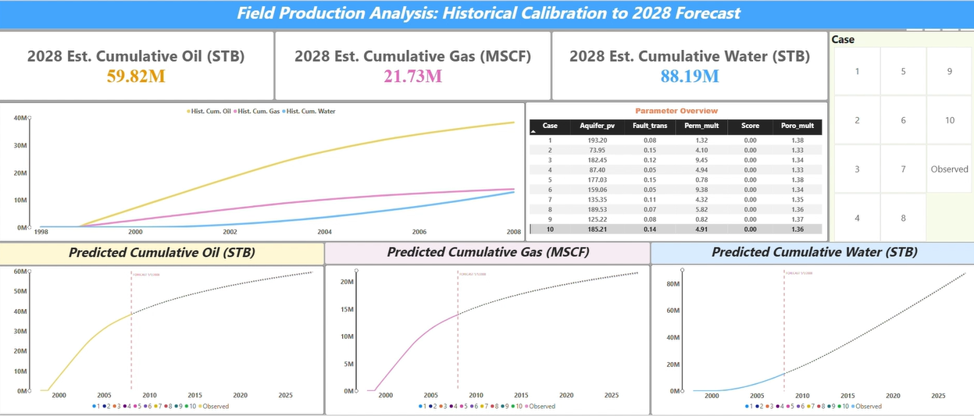
Dashboard

